Slide 1


Credit Card Fraud Detection
Milestone 3 Presentation | Armin Heldovac | DSC 680

Slide 2
Introduction & Purpose
Credit card fraud is a growing problem in digital transactions.
The goal is to detect fraudulent transactions using machine learning to reduce losses for financial institutions and protect customers.

Slide 3
Background & Context
Traditional rule-based systems are limited and easily bypassed.
Machine learning can detect complex and evolving fraud patterns.

Slide 4

Methods
1. Preprocess data & handle class imbalance.
1
2. Perform EDA to identify fraud behavior patterns.
2
3. Train models: Logistic Regression, Random Forest, XGBoost.
3
4. Evaluate models using ROC-AUC, Precision, Recall, F1.
4

Slide 5
Key EDA Findings
- Fraud makes up only 0.172% of transactions.
- Fraudulent transactions tend to be lower in amount.
- Features V14, V12, and V17 show strong fraud correlation.

Slide 6
Model Performance Results
Logistic Regression: ROC-AUC 0.93 | Recall 0.65
Random Forest: ROC-AUC 0.97 | Recall 0.83
XGBoost: ROC-AUC 0.985 | Recall 0.90 (Best performance)

Slide 7
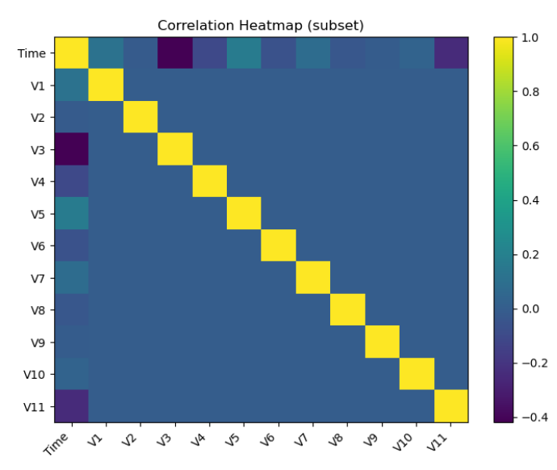
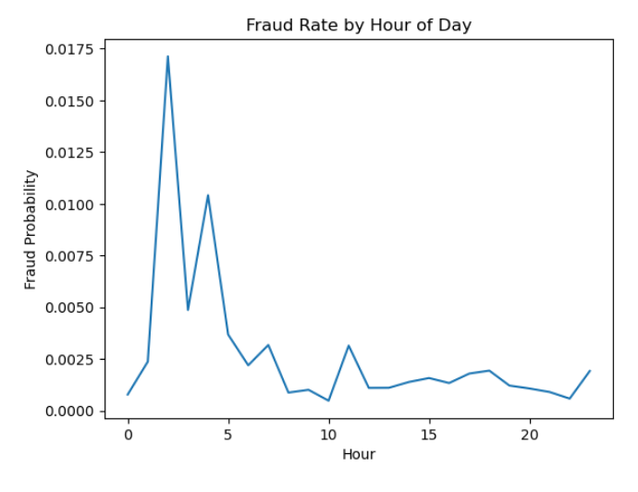
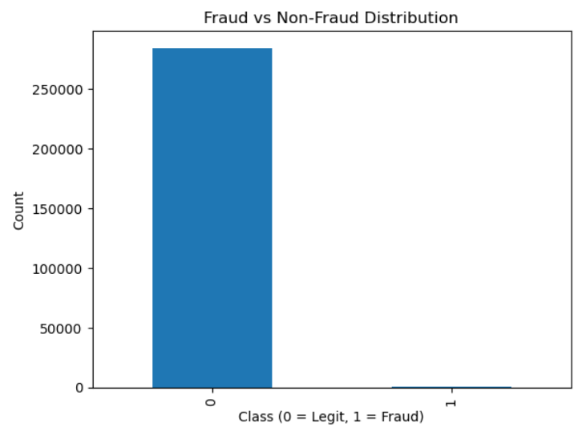
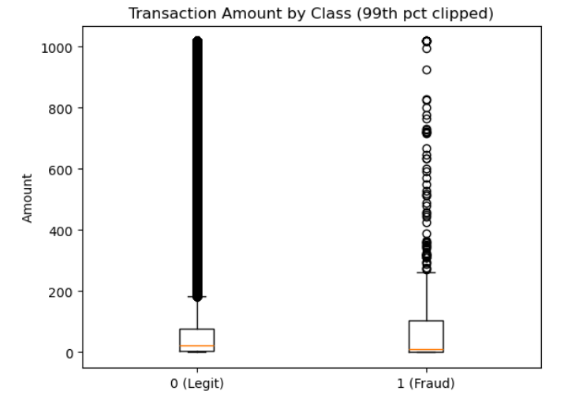
Visualizations

Slide 8
Interpretation
- XGBoost detected the most fraud with highest recall.
- Random Forest provided strong balance of precision and recall.
- Logistic Regression is not suitable as a standalone fraud detector.

Slide 9
Ethical Considerations
- False positives may inconvenience customers.
- System must avoid geographic or demographic bias.
- Fraud detection must preserve privacy & transparency.

Slide 10
Limitations & Challenges
- Dataset is anonymized, limiting interpretability.
- Fraud patterns evolve, requiring frequent retraining.
- Tradeoff between recall (catching fraud) and precision (avoiding false alarms).

Slide 11
Recommendations
1. Deploy XGBoost or Random Forest.
2. Adjust probability thresholds to balance false positives.
3. Continually retrain with new transaction data.

Slide 12
Q&A Preparation
Q: Why prioritize recall?
A: Missing fraud is more costly than investigating false alerts.
Q: Why use ML instead of rules?
A: Fraud tactics evolve too quickly for static rules.

